Slide 1

Parallel Computing with MPI Finding meaning after Moore’s Law.

Slide 2
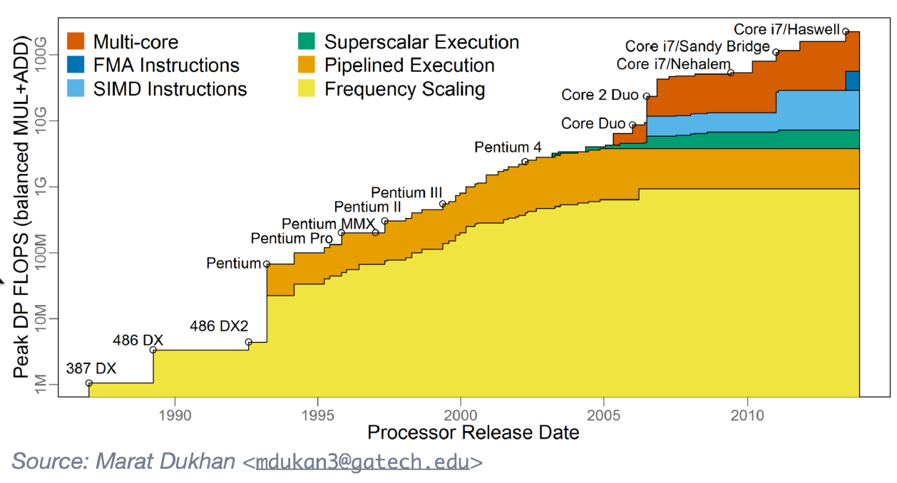
Why parallel computing?
Used to gain speed by bumping up clock rates (yellow).
Turned out the increased heat emissions limited our ability to do that.
Some attempts at more “parallel-like” computing (pipelining, SIMD, etc.)
Truly parallel computing came with multi-processor, multi-core (dark orange)

Slide 3
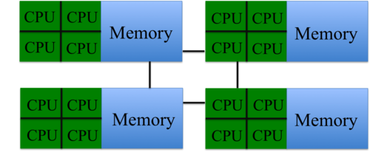
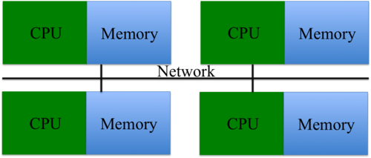
Memory Organization
Shared Memory
Different processors have physical access to the same memory (bus-based)
Can share the same logical view of memory
My array is your array
This is what OpenMP is for (in C, C++ and Fortran)
Julia has Threads
Distributed Memory
Processors require using the network to access memory from other nodes
Needs communications from other processes for data exchange
I need your array results, please hand them over
This is what MPI is for
Julia has MPI.jl

Slide 4
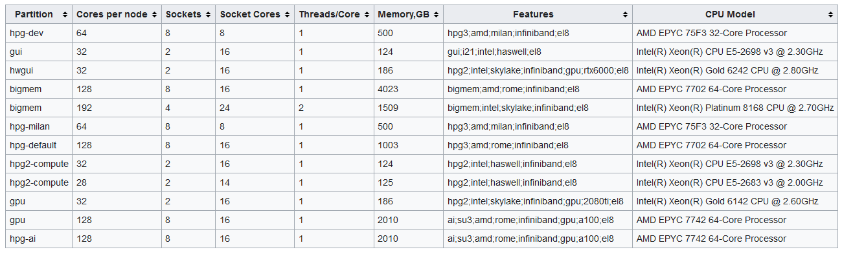
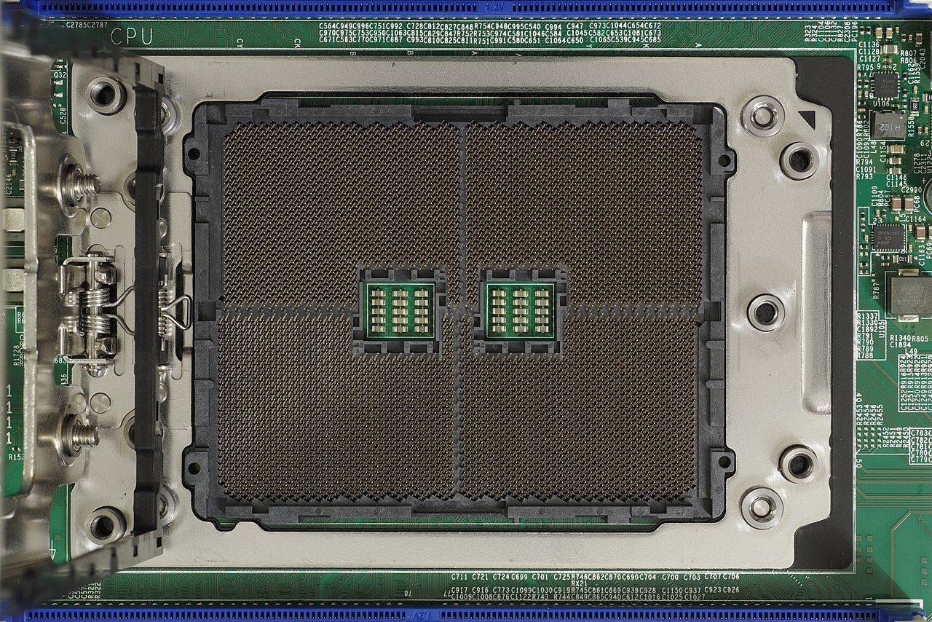
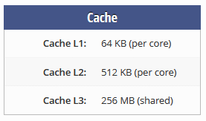
What does HiPerGator look like?
Let’s look at hpg-dev:
Each node is probably a single motherboard
8 Sockets for 2 CPUs
32 Cores per CPU
SMT disabled (Simultaneous Multithreading or Hyperthreading)
Each CPU has its own shared memory between cores (L3 cache)
Each motherboard has 500GB of RAM, with the 2 CPUs connected by a memory bus
They use SMP (Symmetric Multiprocessing) so they can communicate on RAM)

Slide 5


MPI.jl
Letting you code like a C (not even C++) programmer again

Slide 6

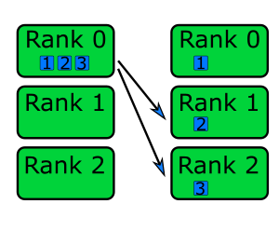
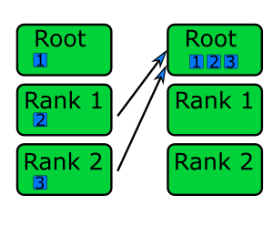
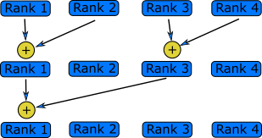
Using MPI for Multiple Nodes and what it is?
MPI (Message Passing Interface) by itself is a standard
This standard is implemented by different groups
HiPerGator specifically has OpenMPI: https://www.open-mpi.org/
Meant for allowing different processes with their own private memory spaces to communicate between each other
Perfect for distributed memory systems since processors on one node can’t see memory located on another node
Implements message sending/receiving, data gathering/scattering and reduction algorithms

Slide 7
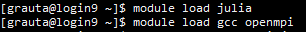
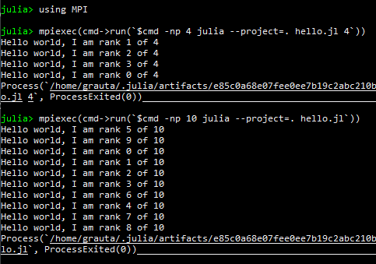
Basic MPI Example
using MPI
MPI.Init()
comm = MPI.COMM_WORLD
println("Hello world, I am rank $(MPI.Comm_rank(comm)) of $(MPI.Comm_size(comm))")
MPI.Barrier(comm)
MPI.Finalize() # Optional
https://juliaparallel.org/MPI.jl/latest/examples/01-hello/

Slide 8
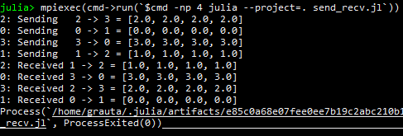
Sending and Receiving
If we have different processes running, we need to communicate information between them
We can use MPI.Send to send data out from a buffer to a specific rank
We can use MPI.Recv to receive a message from a specific rank and store it in a buffer
There is also MPI.Isend and MPI.Irecv for non-blocking communications (I can keep working while waiting for other communications)
If we need a data from a non-blocking communication, we can MPI.Wait for it
https://juliaparallel.org/MPI.jl/latest/examples/04-sendrecv/

Slide 9
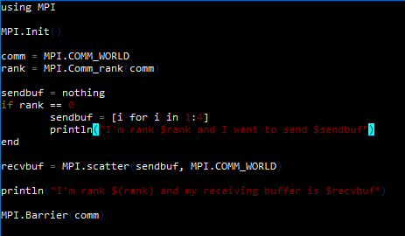
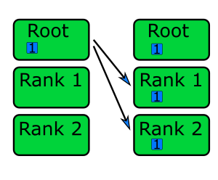
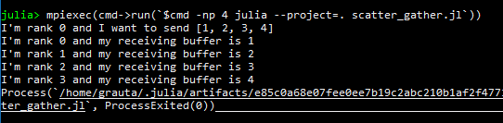
Scattering/Gathering/Broadcasting
Can distribute data from one rank (usually 0) to many others
Scatter splits data into chunks and sends an equal part to each rank
Gather collects those chunks into one rank
Broadcasting sends a single result into all ranks

Slide 10
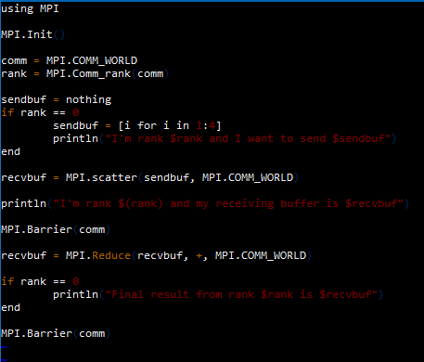
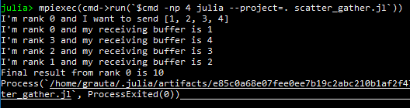
Reductions
Parallel primitives that can efficiently “reduce” values
Common reductions are addition, multiplication, min, max, etc.
Gathers result into a single rank
Can use MPI.Allreduce to Bcast result to all ranks

Slide 11
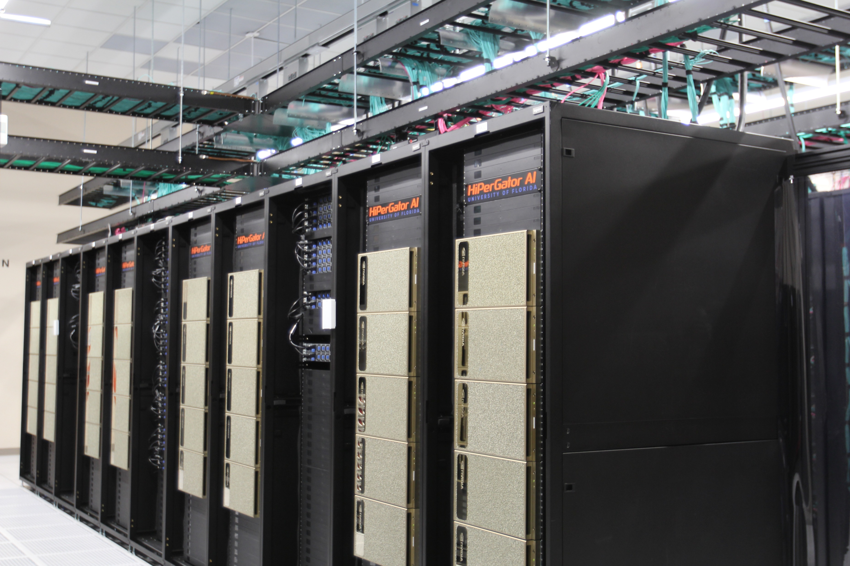
Many other cool things
We’ve covered the basics but there is a lot more…
Scans (Basically prefix sum stuff)
Reductions as a Julia function
Remote Memory Access (NVSHMEMRMA which is a real acronym)
Communicating along a Graph Topology
More communicators than just COMM_WORLD
And probably a lot more!

Slide 12

PartitionedArrays.jl
“This package provides distributed (a.k.a. partitioned) vectors and sparse matrices like the ones needed in distributed finite differences, finite volumes, or finite element computations.”
“The main objective of this package is to avoid to interface directly with MPI or MPI-based libraries when prototyping and debugging distributed parallel codes.”

Slide 13
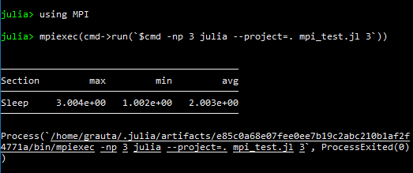
PartitionedArrays Example
using PartitionedArrays
with_mpi() do distribute
np = 3
ranks = distribute(LinearIndices((np,)))
t = PTimer(ranks)
tic!(t)
map(ranks) do rank
sleep(rank)
end
toc!(t,"Sleep")
display(t)
end

Slide 14
Test with SPMV(SParse Matrix Vector multiplication)
Created a million-by-million sparse tridiagonal matrix
Distributed it among multiple MPI ranks
Distribute the required vector information to the appropriate ranks
Compute the product
In PartitionedArrays.jl, easy as doing A*x

Slide 15

What the future holds…
Kernal Abstractions (Shared Memory)
MPI (Distributed Memory)
CUDA-aware MPI (https://developer.nvidia.com/blog/introduction-cuda-aware-mpi/)
(https://docs.open-mpi.org/en/v5.0.x/tuning-apps/networking/cuda.html)

